Slide 1
18CSC205J - OPERATING SYSTEMS
UNIT-1
SRM Institute of Science and Technology, Ramapuram

Slide 2
Operating Systems - Syllabus
Operating System Objectives and functions - Gaining the role of Operating systems - The evolution of operating system, Major Achievements - Understanding the evolution of Operating systems from early batch processing systems to modern complex systems - Process Concept– Processes, PCB - Understanding the Process concept and Maintenance of PCB by OS -Threads – Overview and its Benefits - Understanding the importance of threads - Process Scheduling : Scheduling Queues, Schedulers, Context switch - Understanding basics of Process Scheduling - Operations on Process – Process creation, Process termination - Understanding the system calls – fork(),wait(),exit() - Inter Process communication : Shared Memory, Message Passing ,Pipe() -Understanding the need for IPC - Process synchronization: Background, Critical section Problem - Understanding the race conditions and the need for the Process synchronization.
SRM Institute of Science and Technology, Ramapuram

Slide 3
Operating System Objectives
Definitions of Operating System:
  An Operating System is a program that manages a computer’s hardware.
  An Operating System is a program that acts as an intermediary between a user of a computer and the computer hardware.
Operating system objectives:
  Convenience: An Operating System makes a computer more convenient to use.
  Efficiency: An Operating System allows the computer system resources to be used in an efficient manner.
  Ability to evolve: An Operating System should be constructed in such a way as to permit the effective development, testing, and introduction of new system functions without interfering with service.
SRM Institute of Science and Technology, Ramapuram

Slide 4
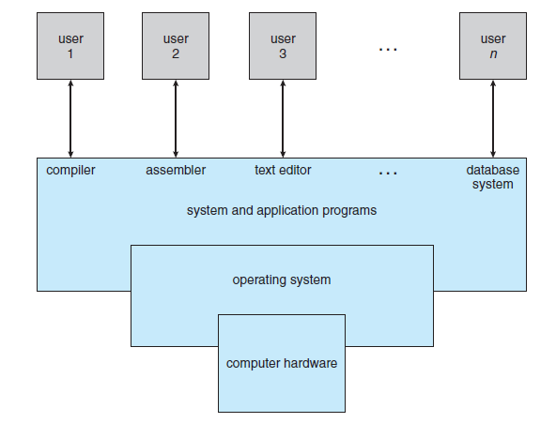
Operating System Objectives
A computer system can be divided into four components:
Fig: Abstract view of the components of a computer system
SRM Institute of Science and Technology, Ramapuram

Slide 5
Operating System Objectives
    Hardware – provides basic computing resources (CPU, memory, I/O devices).
    Operating system – controls and coordinates the use of the hardware among the various application programs for the various users.
    Applications programs – define the ways in which the system resources are used to solve the computing problems of the users (compilers, database systems, video games, business programs).
    Users (people, machines, other computers).
SRM Institute of Science and Technology, Ramapuram

Slide 6
Operating System Objectives
Operating system can be explored from two viewpoints: the user and the system.
User view:
Most computer users sit in front of a PC.
  Such a system is designed for one user to monopolize its resources, to maximize the work that the user is performing.
  In this case the operating system is designed mostly for ease of use, with some attention paid to performance and none to resource utilization.
  Performance is important to the user, but it does not matter if most of the system is sitting idle, waiting for the slow I/O speed of the user.
SRM Institute of Science and Technology, Ramapuram

Slide 7
Operating System Objectives
Some users sit at a terminal connected to a mainframe or minicomputer.
  Share resources and exchange information.
  The operating system is designed to maximize resource utilization.
  To assure that all available CPU time, memory, and I/O are used efficiently, and that no individual user takes more than her fair share.
Other users sit at workstations, connected to networks of other workstations and servers.
  Operating system is designed to compromise between individual usability and resource utilization.
SRM Institute of Science and Technology, Ramapuram

Slide 8
Operating System Objectives
System view:
From the computer's point of view, the operating system is the program that is most intimate with the Hardware.
Resource allocator – manages and allocates resources. A computer system has many resources- hardware and software- that may be required to solve the problem: CPU time, memory space, file-storage space, I/O devices and so on.
Control program – controls the execution of user programs and operations of I/O devices to prevent errors and improper use of the computer.
Kernel – the one program running at all times on the computer with all else being application programs.
SRM Institute of Science and Technology, Ramapuram

Slide 9
Operating System Functions
The OS typically provides services in the following areas:
Program development: The OS provides a variety of facilities and services, such as editors and debuggers, to assist the programmer in creating programs.
Program execution: A number of steps need to be performed to execute a program. Instructions and data must be loaded into main memory, I/O devices and files must be initialized, and other resources must be prepared. The OS handles these scheduling duties for the user.
Access to I/O devices: Each I/O device requires its own peculiar set of instructions or control signals for operation. The OS provides a uniform interface that hides these details so that programmers can access such devices using simple reads and writes.
SRM Institute of Science and Technology, Ramapuram

Slide 10
Operating System Functions
Controlled access to files: For file access, the OS must reflect a detailed understanding of not only the nature of the I/O device (disk drive, tape drive) but also the structure of the data contained in the files on the storage medium.
System access: For shared or public systems, the OS controls access to the system as a whole and to specific system resources. The access function must provide protection of resources and data from unauthorized users and must resolve conflicts for resource contention.
Error detection and response: A variety of errors can occur while a computer system is running. The OS must provide a response that clears the error condition with the least impact on running applications.
Accounting: A good OS will collect usage statistics for various resources and monitor performance parameters such as response time.
SRM Institute of Science and Technology, Ramapuram

Slide 11
Role of Operating Systems
The Operating System as a User/Computer Interface
The hardware and software used in providing applications to a user can be viewed in a layered or hierarchical fashion.
The user of those applications, the end user, generally is not concerned with the details of computer hardware.
Thus, the end user views a computer system in terms of a set of applications.
An application can be expressed in a programming language and is developed by an application programmer.
To ease this chore, a set of system programs is provided. Some of these programs are referred to as utilities, or library programs.
SRM Institute of Science and Technology, Ramapuram

Slide 12
Role of Operating Systems
These implement frequently used functions that assist in program creation, the management of files, and the control of I/O devices. The most important collection of system programs comprises the OS.
The OS masks the details of the hardware from the programmer and provides the programmer with a convenient interface for using the system.
It acts as mediator, making it easier for the programmer and for application programs to access and use those facilities and services.
SRM Institute of Science and Technology, Ramapuram

Slide 13
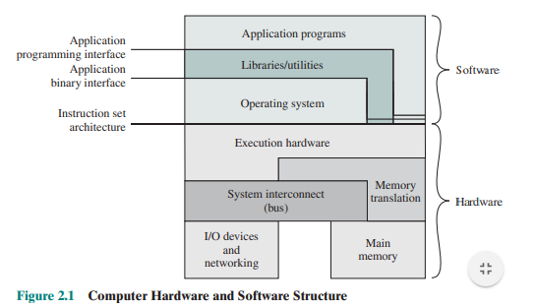
Role of Operating Systems
Computer Hardware and Software
SRM Institute of Science and Technology, Ramapuram

Slide 14
Role of Operating Systems
The OS typically provides services in the following areas:
Program development: The OS provides a variety of facilities and services, such as editors and debuggers, to assist the programmer in creating programs.
Program execution: A number of steps need to be performed to execute a program. Instructions and data must be loaded into main memory, I/O devices and files must be initialized, and other resources must be prepared. The OS handles these scheduling duties for the user.
Access to I/O devices: Each I/O device requires its own peculiar set of instructions or control signals for operation. The OS provides a uniform interface that hides these details so that programmers can access such devices using simple reads and writes.
SRM Institute of Science and Technology, Ramapuram

Slide 15
Role of Operating Systems
Controlled access to files: For file access, the OS must reflect a detailed understanding of not only the nature of the I/O device (disk drive, tape drive) but also the structure of the data contained in the files on the storage medium.
System access: For shared or public systems, the OS controls access to the system as a whole and to specific system resources. The access function must provide protection of resources and data from unauthorized users and must resolve conflicts for resource contention.
Error detection and response: A variety of errors can occur while a computer system is running. The OS must provide a response that clears the error condition with the least impact on running applications.
Accounting: A good OS will collect usage statistics for various resources and monitor performance parameters such as response time.
SRM Institute of Science and Technology, Ramapuram

Slide 16
Role of Operating Systems
The Figure also indicates three key interfaces in a typical computer system.
  Instruction set architecture (ISA): The ISA defines the repertoire of machine language instructions that a computer can follow. This interface is the boundary between hardware and software.
  Application binary interface (ABI): The ABI defines a standard for binary portability across programs. The ABI defines the system call interface to the operating system and the hardware resources and services available in a system through the user ISA.
  Application programming interface (API): The API gives a program access to the hardware resources and services available in a system through the user ISA supplemented with high-level language (HLL) library calls. Using an API enables application software to be ported easily, to other systems that support the same API.
SRM Institute of Science and Technology, Ramapuram

Slide 17
Role of Operating Systems
The Operating System as Resource Manager
A computer is a set of resources for the movement, storage, and processing of data and for the control of these functions.
The OS is responsible for managing these resources.
The OS functions in the same way as ordinary computer software; that is, it is a program or suite of programs executed by the processor.
The OS frequently relinquishes control and must depend on the processor to allow it to regain control.
Like other computer programs, the OS provides instructions for the processor. The OS directs the processor in the use of the other system resources and in the timing of its execution of other programs.
A portion of the OS is in main memory. This includes the kernel, or nucleus, which contains the most frequently used functions in the OS and, at a given time, other portions of the OS currently in use.
SRM Institute of Science and Technology, Ramapuram

Slide 18
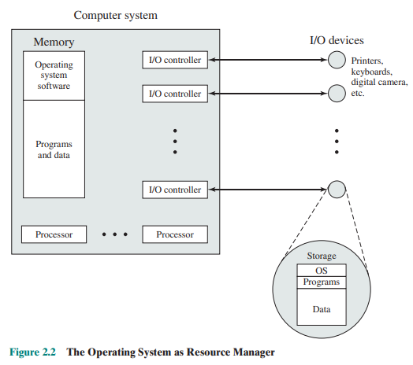
Role of Operating Systems
The remainder of main memory contains user programs and data. The memory management hardware in the processor and the OS jointly control the allocation of main memory. The OS decides when an I/O device can be used by a program in execution and controls access to and use of files.
The processor itself is a resource, and the OS must determine how much processor time is to be devoted to the execution of a particular user program. In the case of a multiple-processor system, this decision must span all of the processors.
The Operating System as Resource Manager
SRM Institute of Science and Technology, Ramapuram

Slide 19
Evolution of Operating Systems
A major OS will evolve over time for a number of reasons.
Hardware upgrades plus new types of hardware: For example, early versions of UNIX and the Macintosh OS did not employ a paging mechanism because they were run on processors without paging hardware. Subsequent versions of these operating systems were modified to exploit paging capabilities.
  New services: In response to user demand or in response to the needs of system managers, the OS expands to offer new services.
  Fixes: Any OS has faults. These are discovered over the course of time and fixes are made. Of course, the fix may introduce new faults. The need to change an OS regularly places certain requirements on its design.
SRM Institute of Science and Technology, Ramapuram

Slide 20
Evolution of Operating Systems
There are two basic types of operating system single-user and multi-user.
A multi-user operating system handles multiple users as well as multiple peripheral devices simultaneously.
Such an operating system is more than single-user OS.
Single user systems: A personal computer is a popular single user system. The PC is a small general-purpose system that can execute programs to perform a wide verity of tasks.
Multi-user system: When a number of programs have to be run simultaneously or common resources like printers and disks are to be shared by a number of users.
SRM Institute of Science and Technology, Ramapuram

Slide 21
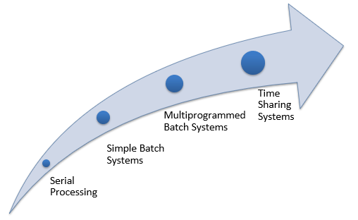
Evolution of Operating Systems
SRM Institute of Science and Technology, Ramapuram

Slide 22
Evolution of Operating Systems
Serial Processing:
In 1950’s programmer directly interact with hardware.
If a programmer wish to execute a program the following steps are maintained.
    Type the program on the punch cards.
    Convert the punch card to card reader
    Then submitting to computing machine If it founds any error, the error condition was indicated by light
    The programmer examines the register and main memory to identify the cause of the error.
    Take the output on the printer
    The system is ready to execute next program.
SRM Institute of Science and Technology, Ramapuram

Slide 23
Evolution of Operating Systems
This type of operation termed as processing. It is difficult for users, it takes much time and next program should wait for the completion of previous task. The programs are executed one after other is known as serial processing.
Drawbacks:
It is difficult to execute a program using computer
It takes much time to execute a single program
CPU is idle, when the currently running process is waiting for some I/O
SRM Institute of Science and Technology, Ramapuram

Slide 24

Evolution of Operating Systems
Batch Systems:
Early computers run from a console.
The common input devices were card readers and tape drives.
The common output devices were line printers, tape drives, and card punches.
The user did not interact directly with the computer systems. Rather, the user prepared a job-which consisted of the program, the data, and some control information about the nature of the job and submitted it to the computer operator.
Memory layout for a simple batch system
SRM Institute of Science and Technology, Ramapuram

Slide 25
Evolution of Operating Systems
Batch Systems:
The job was usually in the form of punch cards. At some later time, the output appeared. The output consisted of the result of the program, as well as a dump of the final memory and register contents for debugging.
The operating system in these early computers was fairly simple.
Its major task was to transfer control automatically from one job to the next. The operating system was always resident in memory.
To speed up processing, operators batched together jobs with similar needs and ran them through the computer as a group.
Thus, the programmers would leave their programs with the operator.
The operator would sort programs into batches with similar requirements and, as the computer became available, would run each batch.
SRM Institute of Science and Technology, Ramapuram

Slide 26
Evolution of Operating Systems
The output from each job would be sent back to the appropriate programmer.
In this execution environment, even a slow CPU works in the microsecond range, with thousands of instructions executed per second.
A fast card reader, on the other hand, might read 1200 cards per minute.
With direct access to several jobs, the operating system could perform job scheduling, to use resources and perform tasks efficiently.
SRM Institute of Science and Technology, Ramapuram

Slide 27

Evolution of Operating Systems
Multiprogrammed Systems
The most important aspect of job scheduling is the ability to multiprogram.
A single user cannot, in general, keep either the CPU or the 1/0 devices busy at all times.
Multiprogramming increases CPU utilization by organizing jobs so that the CPU always has one to execute.
Memory layout for a Multiprogramming System
SRM Institute of Science and Technology, Ramapuram

Slide 28
Evolution of Operating Systems
The idea is as follows:
The operating system keeps several jobs in memory simultaneously.
This set of jobs is a subset of the jobs kept in the job pool.
The operating system picks and begins to execute one of the jobs in the memory.
Eventually, the job may have to wait for some task, such as an I/O operation, to complete.
In a non-Multiprogrammed system, the CPU would sit idle.
In a multiprogramming system, the operating system simply switches to, and executes, another job. When that job needs to wait, the CPU is switched to another job, and so on
SRM Institute of Science and Technology, Ramapuram

Slide 29
Evolution of Operating Systems
Time-Sharing Systems
Time sharing (or multitasking) is a logical extension of multiprogramming.
The CPU executes multiple jobs by switching among them, but the switches occur so frequently that the users can interact with each program while it is running.
An interactive (or hands-on) computer system provides direct communication between the user and the system.
The user gives instructions to the operating system or to a program directly, using a keyboard or a mouse, and waits for immediate results.
A time-shared operating system allows many users to share the computer simultaneously.
SRM Institute of Science and Technology, Ramapuram

Slide 30
Evolution of Operating Systems
It uses CPU scheduling and multiprogramming to provide each user with a small portion of a time-shared computer.
Each user has at least one separate program in memory. A program loaded into memory and executing is commonly referred to as a process.
When a process executes, it typically executes for only a short time before it either finishes or needs to perform I/O.
Rather than let the CPU sit idle when this interactive input takes place, the operating system will rapidly switch the CPU to the program of some other user.
SRM Institute of Science and Technology, Ramapuram

Slide 31
Major Achievements
Process Management
Memory Management
Storage Management
I/O Subsystem
Protection and Security
SRM Institute of Science and Technology, Ramapuram

Slide 32
Major Achievements
Process Management
A process is a program in execution. It is a unit of work within the system. Program is a passive entity, process is an active entity.
Process needs resources to accomplish its task
  CPU, memory, I/O, files
  Initialization data
Process termination requires reclaim of any reusable resources
Single-threaded process has one program counter specifying location of next instruction to execute
  Process executes instructions sequentially, one at a time, until completion
Multi-threaded process has one program counter per thread
Typically system has many processes, some user, some operating system running concurrently on one or more CPUs
  Concurrency by multiplexing the CPUs among the processes / threads
SRM Institute of Science and Technology, Ramapuram

Slide 33
Major Achievements
The operating system is responsible for the following activities in connection with process management:
  Creating and deleting both user and system processes
  Suspending and resuming processes
  Providing mechanisms for process synchronization
  Providing mechanisms for process communication
  Providing mechanisms for deadlock handling
SRM Institute of Science and Technology, Ramapuram

Slide 34
Major Achievements
Memory Management
To execute a program all (or part) of the instructions must be in memory
All (or part) of the data that is needed by the program must be in memory.
Memory management determines what is in memory and when
  Optimizing CPU utilization and computer response to users
Memory management activities
  Keeping track of which parts of memory are currently being used and by whom
  Deciding which processes (or parts thereof) and data to move into and out of memory
  Allocating and deallocating memory space as needed
SRM Institute of Science and Technology, Ramapuram

Slide 35

Major Achievements
Performance of Various Levels of Storage
SRM Institute of Science and Technology, Ramapuram

Slide 36
Major Achievements
I/O Subsystem
One purpose of OS is to hide peculiarities of hardware devices from the user
I/O subsystem responsible for
  Memory management of I/O including buffering (storing data temporarily while it is being transferred), caching (storing parts of data in faster storage for performance), spooling (the overlapping of output of one job with input of other jobs)
  General device-driver interface
  Drivers for specific hardware devices
SRM Institute of Science and Technology, Ramapuram

Slide 37
Major Achievements
Protection and Security
Protection – any mechanism for controlling access of processes or users to resources defined by the OS
Security – defense of the system against internal and external attacks
  Huge range, including denial-of-service, worms, viruses, identity theft, theft of service
Systems generally first distinguish among users, to determine who can do what
  User identities (user IDs, security IDs) include name and associated number, one per user
  User ID then associated with all files, processes of that user to determine access control
  Group identifier (group ID) allows set of users to be defined and controls managed, then also associated with each process, file
  Privilege escalation allows user to change to effective ID with more rights
SRM Institute of Science and Technology, Ramapuram

Slide 38
Evolution of Operating Systems
A major OS will evolve over time for a number of reasons.
Hardware upgrades plus new types of hardware: For example, early versions of UNIX and the Macintosh OS did not employ a paging mechanism because they were run on processors without paging hardware. Subsequent versions of these operating systems were modified to exploit paging capabilities.
  New services: In response to user demand or in response to the needs of system managers, the OS expands to offer new services.
  Fixes: Any OS has faults. These are discovered over the course of time and fixes are made. Of course, the fix may introduce new faults. The need to change an OS regularly places certain requirements on its design.
SRM Institute of Science and Technology, Ramapuram

Slide 39
Evolution of Operating Systems
There are two basic types of operating system single-user and multi-user.
A multi-user operating system handles multiple users as well as multiple peripheral devices simultaneously.
Such an operating system is more than single-user OS.
Single user systems: A personal computer is a popular single user system. The PC is a small general-purpose system that can execute programs to perform a wide verity of tasks.
Multi-user system: When a number of programs have to be run simultaneously or common resources like printers and disks are to be shared by a number of users.
SRM Institute of Science and Technology, Ramapuram

Slide 40
Evolution of Operating Systems
Serial Processing:
In 1950’s programmer directly interact with hardware.
If a programmer wish to execute a program the following steps are maintained.
    Type the program on the punch cards.
    Convert the punch card to card reader
    Then submitting to computing machine If it founds any error, the error condition was indicated by light
    The programmer examines the register and main memory to identify the cause of the error.
    Take the output on the printer
    The system is ready to execute next program.
SRM Institute of Science and Technology, Ramapuram

Slide 41
Evolution of Operating Systems
This type of operation termed as processing. It is difficult for users, it takes much time and next program should wait for the completion of previous task. The programs are executed one after other is known as serial processing.
Drawbacks:
It is difficult to execute a program using computer
It takes much time to execute a single program
CPU is idle, when the currently running process is waiting for some I/O
SRM Institute of Science and Technology, Ramapuram

Slide 42
Evolution of Operating Systems
Batch Systems:
Early computers run from a console.
The common input devices were card readers and tape drives.
The common output devices were line printers, tape drives, and card punches.
The user did not interact directly with the computer systems. Rather, the user prepared a job-which consisted of the program, the data, and some control information about the nature of the job and submitted it to the computer operator.
Memory layout for a simple batch system
SRM Institute of Science and Technology, Ramapuram

Slide 43
Evolution of Operating Systems
Batch Systems:
The job was usually in the form of punch cards. At some later time, the output appeared. The output consisted of the result of the program, as well as a dump of the final memory and register contents for debugging.
The operating system in these early computers was fairly simple.
Its major task was to transfer control automatically from one job to the next. The operating system was always resident in memory.
To speed up processing, operators batched together jobs with similar needs and ran them through the computer as a group.
Thus, the programmers would leave their programs with the operator.
The operator would sort programs into batches with similar requirements and, as the computer became available, would run each batch.
SRM Institute of Science and Technology, Ramapuram

Slide 44
Evolution of Operating Systems
The output from each job would be sent back to the appropriate programmer.
In this execution environment, even a slow CPU works in the microsecond range, with thousands of instructions executed per second.
A fast card reader, on the other hand, might read 1200 cards per minute.
With direct access to several jobs, the operating system could perform job scheduling, to use resources and perform tasks efficiently.
SRM Institute of Science and Technology, Ramapuram

Slide 45
Evolution of Operating Systems
Multiprogrammed Systems
The most important aspect of job scheduling is the ability to multiprogram.
A single user cannot, in general, keep either the CPU or the 1/0 devices busy at all times.
Multiprogramming increases CPU utilization by organizing jobs so that the CPU always has one to execute.
Memory layout for a Multiprogramming System
SRM Institute of Science and Technology, Ramapuram

Slide 46
Evolution of Operating Systems
The idea is as follows:
The operating system keeps several jobs in memory simultaneously.
This set of jobs is a subset of the jobs kept in the job pool.
The operating system picks and begins to execute one of the jobs in the memory.
Eventually, the job may have to wait for some task, such as an I/O operation, to complete.
In a non-Multiprogrammed system, the CPU would sit idle.
In a multiprogramming system, the operating system simply switches to, and executes, another job. When that job needs to wait, the CPU is switched to another job, and so on
SRM Institute of Science and Technology, Ramapuram

Slide 47
Evolution of Operating Systems
Time-Sharing Systems
Time sharing (or multitasking) is a logical extension of multiprogramming.
The CPU executes multiple jobs by switching among them, but the switches occur so frequently that the users can interact with each program while it is running.
An interactive (or hands-on) computer system provides direct communication between the user and the system.
The user gives instructions to the operating system or to a program directly, using a keyboard or a mouse, and waits for immediate results.
A time-shared operating system allows many users to share the computer simultaneously.
SRM Institute of Science and Technology, Ramapuram

Slide 48
Evolution of Operating Systems
It uses CPU scheduling and multiprogramming to provide each user with a small portion of a time-shared computer.
Each user has at least one separate program in memory. A program loaded into memory and executing is commonly referred to as a process.
When a process executes, it typically executes for only a short time before it either finishes or needs to perform I/O.
Rather than let the CPU sit idle when this interactive input takes place, the operating system will rapidly switch the CPU to the program of some other user.
SRM Institute of Science and Technology, Ramapuram

Slide 49
Evolution of Operating Systems
Desktop Systems
Personal computers PCs appeared in the 1970s.
During their first decade, the CPUs in PCs lacked the features needed to protect an operating system from user programs.
PC operating systems therefore were neither multiuser nor multitasking.
However, the goals of these operating systems have changed with time; instead of maximizing CPU and peripheral utilization, the systems opt for maximizing user convenience and responsiveness.
Operating systems for these computers have benefited in several ways from the development of operating systems for mainframes.
Microcomputers were immediately able to adopt some of the technology developed for larger operating systems.
SRM Institute of Science and Technology, Ramapuram

Slide 50
Evolution of Operating Systems
On the other hand, the hardware costs for microcomputers are sufficiently low that individuals have sole use of the computer, and CPU utilization is no longer a prime concern.
Thus, some of the design decisions made in operating systems for mainframes may not be appropriate for smaller systems.
SRM Institute of Science and Technology, Ramapuram

Slide 51
Evolution of Operating Systems
Distributed Systems
Distribute the computation among several physical processors.
Loosely coupled system – each processor has its own local memory; processors communicate with one another through various communications lines, such as high-speed buses or telephone lines.
Advantages of distributed systems.
  Resources Sharing
  Computation speed up – load sharing
  Reliability
  Communications
Requires networking infrastructure.
Local area networks (LAN) or Wide area networks (WAN)
SRM Institute of Science and Technology, Ramapuram

Slide 52

Evolution of Operating Systems
Client/server system:
Centralized systems today act as server systems to satisfy requests generated by client systems. The general structure is:
Server systems can be broadly classified into compute server and file server.
  Compute server systems: provide an interface to which clients can send requests to perform an action, in response to which they execute the action and send back results to the client.
  File-server systems provide a file-system interface where clients can create, update, read, and delete files.
SRM Institute of Science and Technology, Ramapuram

Slide 53
Evolution of Operating Systems
Peer-to-Peer Systems:
The computer networks used in these applications consist of a collection of processors that do not share memory or a clock.
Instead, each processor has its own local memory.
The processors communicate with one another through various communication lines, such as high-speed buses or telephone lines.
These systems are usually referred to as loosely coupled systems (or distributed systems).
SRM Institute of Science and Technology, Ramapuram

Slide 54
Evolution of Operating Systems
Clustered Systems
Clustering allows two or more systems to share storage.
Provides high reliability.
Asymmetric clustering: one server runs the application while other servers standby.
Symmetric clustering: all N hosts are running the application.
SRM Institute of Science and Technology, Ramapuram

Slide 55
Evolution of Operating Systems
Real-Time Systems
Often used as a control device in a dedicated application such as controlling scientific experiments, medical imaging systems, industrial control systems, and some display systems.
Well-defined fixed-time constraints.
Real-Time systems may be either hard or soft real-time.
SRM Institute of Science and Technology, Ramapuram

Slide 56
Evolution of Operating Systems
Hard real-time:
  Secondary storage limited or absent, data stored in short term memory, or read-only memory (ROM)
  Conflicts with time-sharing systems, not supported by general-purpose operating systems.
Soft real-time
  Limited utility in industrial control of robotics
  Useful in applications (multimedia, virtual reality) requiring advanced operating-system features.
SRM Institute of Science and Technology, Ramapuram

Slide 57
Evolution of Operating Systems
Handheld Systems
Personal Digital Assistants (PDAs)
Cellular telephones
Issues:
  Limited memory
  Slow processors
  Small display screens.
SRM Institute of Science and Technology, Ramapuram

Slide 58
Multiprocessor and Multicore organization
Symmetric Multiprocessors
Definition: An SMP can be defined as a stand-alone computer system with the following characteristics:
There are two or more similar processors of comparable capability.
These processors share the same main memory and I/O facilities and are interconnected by a bus or other internal connection scheme, such that memory access time is approximately the same for each processor.
All processors share access to I/O devices, either through the same channels or through different channels that provide paths to the same device.
All processors can perform the same functions (hence the term symmetric).
The system is controlled by an integrated operating system that provides interaction between processors and their programs at the job, task, file, and data element levels.
SRM Institute of Science and Technology, Ramapuram

Slide 59
Multiprocessor and Multicore organization
Advantages
Performance: If the work to be done by a computer can be organized so that some portions of the work can be done in parallel, then a system with multiple processors will yield greater performance than one with a single processor of the same type.
Availability: In a symmetric multiprocessor, because all processors can perform the same functions, the failure of a single processor does not halt the machine. Instead, the system can continue to function at reduced performance.
Incremental growth: A user can enhance the performance of a system by adding an additional processor.
Scaling: Vendors can offer a range of products with different price and performance characteristics based on the number of processors configured in the system.
SRM Institute of Science and Technology, Ramapuram

Slide 60
Multiprocessor and Multicore organization
Organization
There are multiple processors, each of which contains its own control unit, arithmetic logic unit, and registers.
Each processor has access to a shared main memory and the I/O devices through some form of interconnection mechanism; a shared bus is a common facility.
The processors can communicate with each other through memory (messages and status information left in shared address spaces). It may also be possible for processors to exchange signals directly. The memory is often organized so that multiple simultaneous accesses to separate blocks of memory are possible.
SRM Institute of Science and Technology, Ramapuram

Slide 61
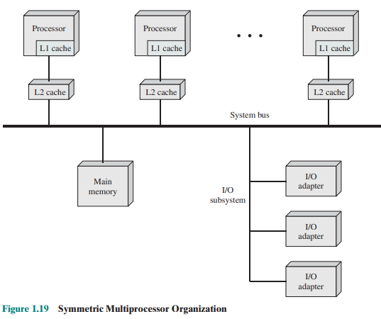
Multiprocessor and Multicore organization
Symmetric Multiprocessor Organization
SRM Institute of Science and Technology, Ramapuram

Slide 62
Multiprocessor and Multicore organization
Cache coherence problem
In modern computers, processors generally have at least one level of cache memory that is private to the processor.
This use of cache introduces some new design considerations. Because each local cache contains an image of a portion of main memory, if a word is altered in one cache, it could conceivably invalidate a word in another cache.
To prevent this, the other processors must be alerted that an update has taken place.
This problem is known as the cache coherence problem and is typically addressed in hardware rather than by the OS.
SRM Institute of Science and Technology, Ramapuram

Slide 63
Multiprocessor and Multicore organization
Multicore Computers
A multicore computer, also known as a chip multiprocessor, combines two or more processors (called cores) on a single piece of silicon (called a die).
Each core consists of all of the components of an independent processor, such as registers, ALU, pipeline hardware, and control unit, plus L1 instruction and data caches. In addition to the multiple cores, contemporary multicore chips also include L2 cache and, in some cases, L3 cache.
SRM Institute of Science and Technology, Ramapuram

Slide 64
Multiprocessor and Multicore organization
Motivation
Microprocessor systems have experienced a steady, usually exponential, increase in performance.
Performance has also been improved by the increased complexity of processor design to exploit parallelism in instruction execution and memory access.
So, the best way to improve performance is to take advantage of advances in hardware is to put multiple processors and a substantial amount of cache memory on a single chip.
An example of a multicore system is the Intel Core i7, which includes four x86 processors, each with a dedicated L2 cache, and with a shared L3 cache as in the below figure.
SRM Institute of Science and Technology, Ramapuram

Slide 65
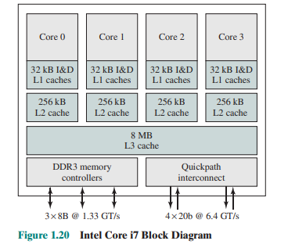
Multiprocessor and Multicore organization
Intel Core i7 Block Diagram
SRM Institute of Science and Technology, Ramapuram

Slide 66
Multiprocessor and Multicore organization
Intel Core i7 Block Diagram
SRM Institute of Science and Technology, Ramapuram

Slide 67
Multiprocessor and Multicore organization
One mechanism Intel uses to make its caches more effective is prefetching, in which the hardware examines memory access patterns and attempts to fill the caches speculatively with data that are likely to be requested soon. The Core i7 chip supports two forms of external communications to other chips.
The DDR3 memory controller
    This brings the memory controller for the DDR (double data rate) main memory onto the chip.
    The interface supports three channels that are 8 bytes wide for a total bus width of 192 bits, for an aggregate data rate of up to 32 GB/s.
    With the memory controller on the chip, the Front Side Bus is eliminated.
SRM Institute of Science and Technology, Ramapuram

Slide 68
Multiprocessor and Multicore organization
The Quick Path Interconnect (QPI)
    It is a point-to-point link electrical interconnect specification.
    It enables high-speed communications among connected processor chips.
    The QPI link operates at 6.4 GT/s (transfers per second).
SRM Institute of Science and Technology, Ramapuram

Slide 69
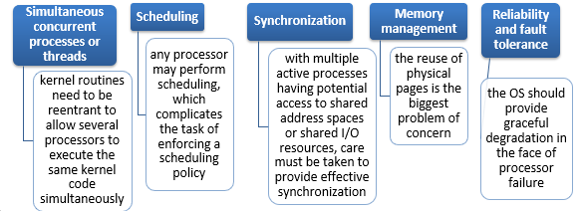
Key Design Issues of Multiprocessor Operating Systems
SRM Institute of Science and Technology, Ramapuram

Slide 70
Key Design Issues of Multiprocessor Operating Systems
Multiprocessor systems with more than on CPU in close communication sharing the computer bus, the clock, and sometimes memory and peripheral devices.
Tightly coupled system – processors share memory and a clock; communication usually takes place through the shared memory.
Advantages of parallel system:
  Increased throughput- By increasing the number of processors, we hope to get more work done in less time.
  Economical - Multiprocessor systems can save more money than multiple single-processor systems, because they can share peripherals, mass storage, and power supplies.
  Increased reliability
    graceful degradation- ability to continue providing service proportional to the level of surviving hardware
    fail-soft systems
SRM Institute of Science and Technology, Ramapuram

Slide 71
Key Design Issues of Multiprocessor Operating Systems
Symmetric multiprocessing (SMP)
  Each processor runs and identical copy of the operating system.
  Many processes can run at once without performance deterioration.
  Most modern operating systems support SMP
Asymmetric multiprocessing
  Each processor is assigned a specific task; master processor schedules and allocated work to slave processors.
  More common in extremely large systems
SRM Institute of Science and Technology, Ramapuram

Slide 72

Key Design Issues of Multiprocessor Operating Systems
Symmetric Multiprocessing Architecture
SRM Institute of Science and Technology, Ramapuram

Slide 73
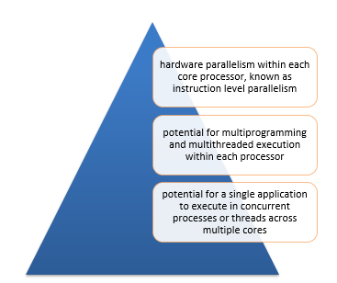
Multicore Operating System
Consideration
The design challenge for a many-core multicore system is to efficiently harness the multicore processing power and intelligently manage the substantial on-chip resources efficiently
Potential for parallelism exists at three levels:
SRM Institute of Science and Technology, Ramapuram

Slide 74
Process Concept
An operating system executes a variety of programs:
  Batch system – jobs
  Time-shared systems – user programs or tasks
Textbook uses the terms job and process almost interchangeably
Process – a program in execution; process execution must progress in sequential fashion
Multiple parts
  The program code, also called text section
  Current activity including program counter, processor registers
  Stack containing temporary data
    Function parameters, return addresses, local variables
  Data section containing global variables
  Heap containing memory dynamically allocated during run time
SRM Institute of Science and Technology, Ramapuram

Slide 75
Process Concept
Program is passive entity stored on disk (executable file), process is active
  Program becomes process when executable file loaded into memory
Execution of program started via GUI mouse clicks, command line entry of its name, etc
One program can be several processes
  Consider multiple users executing the same program
SRM Institute of Science and Technology, Ramapuram

Slide 76

Process Concept
Process in Memory
SRM Institute of Science and Technology, Ramapuram

Slide 77
Process States
As a process executes, it changes state
  new: The process is being created
  running: Instructions are being executed
  waiting: The process is waiting for some event to occur
  ready: The process is waiting to be assigned to a processor
  terminated: The process has finished execution
SRM Institute of Science and Technology, Ramapuram

Slide 78

Process States
SRM Institute of Science and Technology, Ramapuram

Slide 79

Process Control Block(PCB)
SRM Institute of Science and Technology, Ramapuram

Slide 80
Process Control Block(PCB)
Each process is represented in the operating system by a process control block (PCB)-also called a task control block.
Information associated with each process.
Process state: The state may be new, ready, running, waiting, halted, and SO on.
Program counter: The counter indicates the address of the next instruction to be executed for this process.
CPU registers: The registers vary in number and type, depending on the computer architecture. They include accumulators, index registers, stack pointers, and general-purpose registers, plus any condition-code information. Along with the program counter, this state information must be saved when an interrupt occurs, to allow the process to be continued correctly afterward.
SRM Institute of Science and Technology, Ramapuram

Slide 81
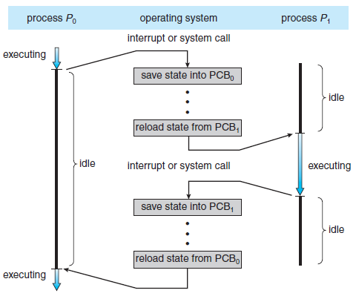
Process Control Block(PCB)
CPU Switch from Process to Process
SRM Institute of Science and Technology, Ramapuram

Slide 82
Process Control Block(PCB)
CPU-scheduling information: This information includes a process priority, pointers to scheduling queues, and any other scheduling parameters.
Memory-management information: This information may include such information as the value of the base and limit registers, the page tables, or the segment tables, depending on the memory system used by the operating system.
Accounting information: This information includes the amount of CPU and real time used, time limits, account numbers, job or process numbers, and so on.
Status information: The information includes the list of I/O devices allocated to this process, a list of open files, and so on.
SRM Institute of Science and Technology, Ramapuram

Slide 83
Threads
A thread, sometimes called a lightweight process (LWP), is a basic unit of CPU utilization; it comprises a thread ID, a program counter, a register set, and a stack.
It shares with other threads belonging to the same process its code section, data section, and other operating-system resources, such as open files and signals.
A traditional (or heavyweight) process has a single thread of control.
If the process has multiple threads of control, it can do more than one task at a time.
SRM Institute of Science and Technology, Ramapuram

Slide 84
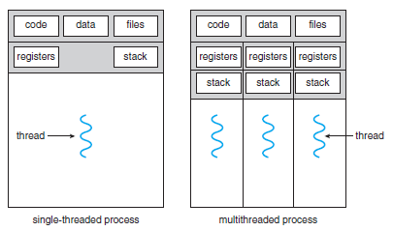
Threads
Single-threaded and Multithreaded processes
SRM Institute of Science and Technology, Ramapuram

Slide 85
Threads
Motivation
Many software packages that run on modern desktop PCs are multithreaded.
An application typically is implemented as a separate process with several threads of control.
A web browser might have one thread display images or text while another thread retrieves data from the network.
A word processor may have a thread for displaying graphics, another thread for reading keystrokes from the user, and a third thread for performing spelling and grammar checking in the background.
SRM Institute of Science and Technology, Ramapuram

Slide 86
Threads
Most modern applications are multithreaded
Threads run within application
Multiple tasks with the application can be implemented by separate threads
  Update display
  Fetch data
  Spell checking
Answer a network request
Process creation is heavy-weight while thread creation is light-weight
Can simplify code, increase efficiency
Kernels are generally multithreaded
SRM Institute of Science and Technology, Ramapuram

Slide 87
Threads
Benefits:
Responsiveness – may allow continued execution if part of process is blocked, especially important for user interfaces
Resource Sharing – threads share resources of process, easier than shared memory or message passing
Economy – cheaper than process creation, thread switching lower overhead than context switching
Scalability – process can take advantage of multiprocessor architectures
SRM Institute of Science and Technology, Ramapuram

Slide 88
Threads
User Threads:
Thread management done by user-level threads library
Examples
  POSIX Pthreads
  Mach C-threads
  Solaris threads
Kernel Threads:
Supported by the Kernel
Examples
  Windows 95/98/NT/2000
  Solaris
  Tru64 UNIX
  BeOS
  Linux
SRM Institute of Science and Technology, Ramapuram

Slide 89
Multithreading Models
Many-to-One
One-to-One
Many-to-Many
SRM Institute of Science and Technology, Ramapuram

Slide 90

Multithreading Models
Many – to - One
SRM Institute of Science and Technology, Ramapuram

Slide 91
Multithreading Models
Many-to-One:
Many user-level threads mapped to single kernel thread
One thread blocking causes all to block
Multiple threads may not run in parallel on muticore system because only one may be in kernel at a time
Few systems currently use this model
Examples:
  Solaris Green Threads
  GNU Portable Threads
SRM Institute of Science and Technology, Ramapuram

Slide 92
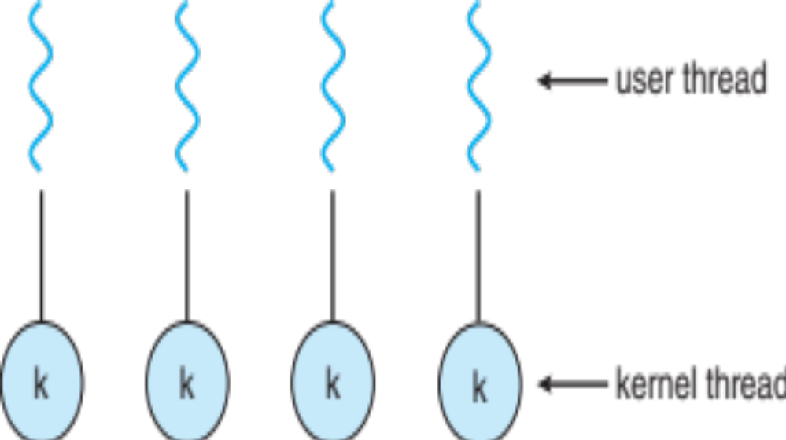
Multithreading Models
One – to – One:
SRM Institute of Science and Technology, Ramapuram

Slide 93
Multithreading Models
One-to-One:
Each user-level thread maps to kernel thread
Creating a user-level thread creates a kernel thread
More concurrency than many-to-one
Number of threads per process sometimes restricted due to overhead
Examples
  Windows
  Linux
  Solaris 9 and later
SRM Institute of Science and Technology, Ramapuram

Slide 94

Multithreading Models
Many-to-Many Model:
SRM Institute of Science and Technology, Ramapuram

Slide 95
Multithreading Models
Many-to-Many Model:
Allows many user level threads to be mapped to many kernel threads.
Allows the operating system to create a sufficient number of kernel threads.
  Solaris 2
  Windows NT/2000 with the ThreadFiber package
SRM Institute of Science and Technology, Ramapuram

Slide 96
Understanding the importance of Threads
Semantics of fork() and exec() system calls.
Thread cancellation.
Signal handling
Thread pools
Thread specific data
SRM Institute of Science and Technology, Ramapuram

Slide 97
Understanding the importance of Threads
The fork and exec System Calls
In a multithreaded program, the semantics of the fork and exec system calls change.
If one thread in a program calls fork, does the new process duplicate all threads or is the new process single-threaded?
Some UNIX systems have chosen to have two versions of fork, one that duplicates all threads and another that duplicates only the thread that invoked the fork system call.
If a thread invokes the exec system call, the program specified in the parameter to exec will replace the entire process-including all threads and LWPs.
Usage of the two versions of fork depends upon the application.
If exec is called immediately after forking, then duplicating all threads is unnecessary, as the program specified in the parameters to exec will replace the process.
SRM Institute of Science and Technology, Ramapuram

Slide 98
Understanding the importance of Threads
Cancellation
Thread cancellation is the task of terminating a thread before it has completed.
For example, if multiple threads are concurrently searching through a database and one thread returns the result, the remaining threads might be cancelled.
Another situation might occur when a user presses a button on a web browser that stops a web page from loading any further.
Often a web page is loaded in a separate thread. When a user presses the stop button, the thread loading the page is cancelled.
A thread that is to be cancelled is often referred to as the target thread.
SRM Institute of Science and Technology, Ramapuram

Slide 99
Understanding the importance of Threads
Cancellation
Thread cancellation is the task of terminating a thread before it has completed.
For example, if multiple threads are concurrently searching through a database and one thread returns the result, the remaining threads might be cancelled.
Another situation might occur when a user presses a button on a web browser that stops a web page from loading any further.
Often a web page is loaded in a separate thread. When a user presses the stop button, the thread loading the page is cancelled.
A thread that is to be cancelled is often referred to as the target thread.
SRM Institute of Science and Technology, Ramapuram

Slide 100
Understanding the importance of Threads
Cancellation of a target thread may occur in two different scenarios:
Asynchronous cancellation: One thread immediately terminates the target thread.
Deferred cancellation: The target thread can periodically check if it should terminate, allowing the target thread an opportunity to terminate itself in an orderly fashion.
The difficulty with cancellation occurs in situations where resources have been allocated to a cancelled thread or if a thread was cancelled while in the middle of updating data it is sharing with other threads.
This becomes especially troublesome with asynchronous cancellation.
SRM Institute of Science and Technology, Ramapuram

Slide 101
Understanding the importance of Threads
The operating system will often reclaim system resources from a cancelled thread, but often will not reclaim all resources.
Therefore, cancelling a thread asynchronously may not free a necessary system-wide resource.
Alternatively, deferred cancellation works by one thread indicating that a target thread is to be cancelled. However, cancellation will occur only when the target thread checks to determine if it should be cancelled or not. This allows a thread to check if it should be cancelled at a point when it can safely be cancelled.
Pthreads refers to such points as cancellation points.
Most operating systems allow a process or thread to be cancelled asynchronously.
SRM Institute of Science and Technology, Ramapuram

Slide 102
Understanding the importance of Threads
Signal Handling
Signals are used in UNIX systems to notify a process that a particular event has occurred.
A signal handler is used to process signals
  Signal is generated by particular event
  Signal is delivered to a process
  Signal is handled by one of two signal handlers:
    default
    user-defined
SRM Institute of Science and Technology, Ramapuram

Slide 103
Understanding the importance of Threads
Every signal has default handler that kernel runs when handling signal
  User-defined signal handler can override default
  For single-threaded, signal delivered to process
Where should a signal be delivered for multi-threaded?
  Deliver the signal to the thread to which the signal applies
  Deliver the signal to every thread in the process
  Deliver the signal to certain threads in the process
  Assign a specific thread to receive all signals for the process
SRM Institute of Science and Technology, Ramapuram

Slide 104
Understanding the importance of Threads
Thread-Local Storage
Thread-local storage (TLS) allows each thread to have its own copy of data
Useful when you do not have control over the thread creation process (i.e., when using a thread pool)
Different from local variables
  Local variables visible only during single function invocation
  TLS visible across function invocations
Similar to static data
  TLS is unique to each thread
SRM Institute of Science and Technology, Ramapuram

Slide 105
Process Scheduling
Process scheduling is the process that selects from among the processes in memory that are ready to execute, and allocates the CPU to one of them.
The objective of
  Multiprogramming is to have some process to run at all times so as to maximize CPU utilization.
  Time-Sharing is to switch the CPU among processes so that users interact with each program while it is running.
SRM Institute of Science and Technology, Ramapuram

Slide 106
Process Scheduling
To meet these objectives, the process scheduler selects an available process for program execution on the CPU.
For a single-processor system, there will never be more than one running process.
If there are more processes, the rest will have to wait until the CPU is free and can be rescheduled.
SRM Institute of Science and Technology, Ramapuram

Slide 107
Scheduling Queues
Scheduling Queues:
Job queue – set of all processes in the system.
Ready queue – set of all processes residing in main memory, ready and waiting to execute.
Device queues – set of processes waiting for an I/O device.
Process migration between the various queues.
SRM Institute of Science and Technology, Ramapuram

Slide 108
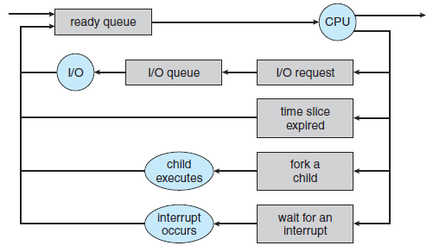
Scheduling Queues
Queueing Diagram representation of Process Scheduling
SRM Institute of Science and Technology, Ramapuram

Slide 109
Scheduling Queues
A common representation of process scheduling is a queueing diagram.
Each rectangular box represents a queue.
Two type of queues are present: the ready queue and a set of device queues.
The circles represent the resources that serve the queues, and the arrows indicate the flow of processes in the system.
A new process is initially put in the ready queue. It waits in the ready queue until it is selected for execution (or dispatched). Once the process is assigned to the CPU and is executing, one of several events could occur:
  The process could issue an I/O request, and then be placed in an I/O queue.
  The process could create a new subprocess and wait for its termination.
  The process could be removed forcibly from the CPU, as a result of an interrupt, and be put back in the ready queue.
SRM Institute of Science and Technology, Ramapuram

Slide 110
Schedulers
Schedulers:
The selection process is carried out by the appropriate scheduler.
Long-term scheduler (or job scheduler) – selects which processes should be brought into the ready queue.
Short-term scheduler (or CPU scheduler) – selects which process should be executed next and allocates CPU.
Short-term scheduler is invoked very frequently (milliseconds) ⇒ (must be fast).
Long-term scheduler is invoked very infrequently (seconds, minutes) ⇒ (may be slow).
SRM Institute of Science and Technology, Ramapuram

Slide 111
Schedulers
The long-term scheduler controls the degree of multiprogramming.
Processes can be described as either:
  I/O-bound process – spends more time doing I/O than computations, many short CPU bursts.
  CPU-bound process – spends more time doing computations; few very long CPU bursts.
SRM Institute of Science and Technology, Ramapuram

Slide 112
Schedulers
Medium-term scheduler:
Removes processes from memory (and from active contention for the CPU), and thus reduces the degree of multiprogramming (no of process in memory).
At some later time, the process can be reintroduced into memory and its execution can be continued where it left off. This scheme is called swapping. The process is swapped out, and is later swapped in, by the medium-term scheduler.
Swapping may be necessary to improve the process mix, or because a change in memory requirements has overcommitted available memory, requiring memory to be freed up.
SRM Institute of Science and Technology, Ramapuram

Slide 113
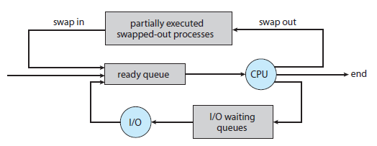
Schedulers
Addition of medium-term scheduling to the Queueing diagram
SRM Institute of Science and Technology, Ramapuram

Slide 114
Context Switch
Context Switch:
When CPU switches to another process, the system must save the state of the old process and load the saved state for the new process.
Context-switch time is overhead; the system does no useful work while switching.
Time dependent on hardware support(1- 1000 microseconds).
SRM Institute of Science and Technology, Ramapuram

Slide 115
Process Scheduling
Process scheduling is the process that selects from among the processes in memory that are ready to execute, and allocates the CPU to one of them.
The objective of
  Multiprogramming is to have some process to run at all times so as to maximize CPU utilization.
  Time-Sharing is to switch the CPU among processes so that users interact with each program while it is running.
SRM Institute of Science and Technology, Ramapuram

Slide 116
Process Scheduling
To meet these objectives, the process scheduler selects an available process for program execution on the CPU.
For a single-processor system, there will never be more than one running process.
If there are more processes, the rest will have to wait until the CPU is free and can be rescheduled.
SRM Institute of Science and Technology, Ramapuram

Slide 117
CPU Scheduling
Basic Concepts
Maximum CPU utilization obtained with multiprogramming
CPU–I/O Burst Cycle – Process execution consists of a cycle of CPU execution and I/O wait.
CPU burst distribution
SRM Institute of Science and Technology, Ramapuram

Slide 118
CPU Scheduling
CPU–I/O Burst Cycle
The success of CPU scheduling depends on an observed property of processes: process execution consists of a cycle of CPU execution and I/O wait.
Processes alternate between these two states. Process execution begins with a CPU burst.
That is followed by an I/O burst, which is followed by another CPU burst, then another I/O burst, and so on. Eventually, the final CPU burst ends with a system request to terminate execution.
SRM Institute of Science and Technology, Ramapuram

Slide 119

CPU Scheduling
Alternating sequence of CPU and I/O bursts.
SRM Institute of Science and Technology, Ramapuram

Slide 120
CPU Scheduling
CPU Scheduler
Selects from among the processes in memory that are ready to execute, and allocates the CPU to one of them.
CPU scheduling decisions may take place when a process:
    Switches from running to waiting state.
    Switches from running to ready state.
    Switches from waiting to ready.
    Terminates.
Scheduling under 1 and 4 is nonpreemptive.
All other scheduling is preemptive.
SRM Institute of Science and Technology, Ramapuram

Slide 121
CPU Scheduling
Preemptive Scheduling
CPU-scheduling decisions may take place under the following four circumstances:
  When a process switches from the running state to the waiting state (for example, as the result of an I/O request or an invocation of wait() for the termination of a child process)
  When a process switches from the running state to the ready state (for example, when an interrupt occurs)
  When a process switches from the waiting state to the ready state (for example, at completion of I/O)
  When a process terminates
When scheduling takes place only under circumstances 1 and 4, we say that the scheduling scheme is nonpreemptive or cooperative. Otherwise, it is preemptive.
SRM Institute of Science and Technology, Ramapuram

Slide 122
CPU Scheduling
Dispatcher
Dispatcher module gives control of the CPU to the process selected by the short-term scheduler; this involves:
  switching context
  switching to user mode
  jumping to the proper location in the user program to restart that program
Dispatch latency – time it takes for the dispatcher to stop one process and start another running.
SRM Institute of Science and Technology, Ramapuram

Slide 123
Scheduling Criteria
CPU utilization – keep the CPU as busy as possible
Throughput – # of processes that complete their execution per time unit
Turnaround time – amount of time to execute a particular process
Waiting time – amount of time a process has been waiting in the ready queue
Response time – amount of time it takes from when a request was submitted until the first response is produced, not output (for time-sharing environment)
Optimization Criteria
It is desirable to maximize CPU utilization and throughput and to minimize turnaround time, waiting time, and response time.
SRM Institute of Science and Technology, Ramapuram

Slide 124
Operations on Process
The processes in the system can execute concurrently, and they must be created and deleted dynamically.
Thus, the operating system must provide a mechanism for
  Process creation and
  Process termination.
SRM Institute of Science and Technology, Ramapuram

Slide 125
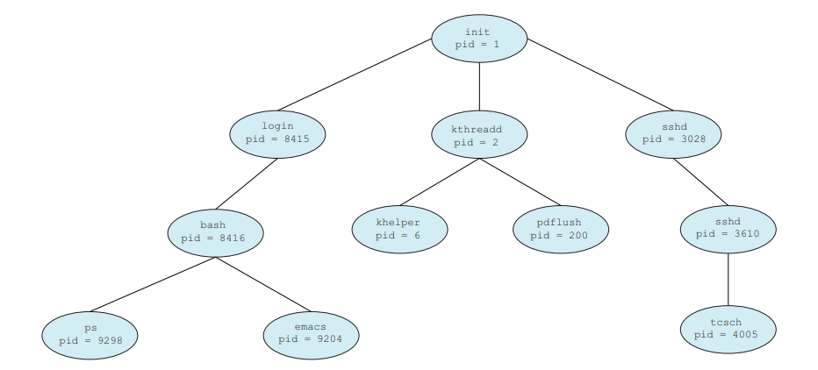
Process Creation
During the course of execution, a process may create several new processes.
As mentioned earlier, the creating process is called a parent process, and the new processes are called the children of that process.
Each of these new processes may in turn create other processes, forming a tree of processes.
A tree of processes on a typical Linux system
SRM Institute of Science and Technology, Ramapuram

Slide 126
Process Creation
Most operating systems identify processes according to a unique process identifier (or pid), which is typically an integer number.
The pid provides a unique value for each process in the system, and it can be used as an index to access various attributes of a process within the kernel.
Resource sharing
  Parent and children share all resources.
  Children share subset of parent’s resources.
  Parent and child share no resources.
Execution
  Parent and children execute concurrently.
  Parent waits until children terminate.
SRM Institute of Science and Technology, Ramapuram

Slide 127
Process Creation
Address space
  Child duplicate of parent.
  Child has a program loaded into it.
UNIX examples
  fork system call creates new process
  exec system call used after a fork to replace the process’ memory space with a new program.
When a process creates a new process, two possibilities exist in terms of execution:
  The parent continues to execute concurrently with its children.
  The parent waits until some or all of its children have terminated.
There are also two possibilities in terms of the address space of the new process:
  The child process is a duplicate of the parent process.
  The child process has a program loaded into it.
SRM Institute of Science and Technology, Ramapuram

Slide 128
Process Creation
Example
Let us consider the UNIX operating system for illustrating the implementation parts.
  In UNIX, every process has a unique process identifier (an integer).
  fork system call creates new process. The child process consists of the copy of the address space of the parent process. Both parent and child processes continue execution at the instruction after the fork.
  execlp system call used after a fork to replace the process’ memory space with a new program. It loads a binary file into memory and starts its execution.
  wait system call moves a process off the ready queue until the termination of the child.
  exit system call completes the parent process resumes from the wait system call when the child process completes.
SRM Institute of Science and Technology, Ramapuram

Slide 129
Process Creation
Example
Let us consider the UNIX operating system for illustrating the implementation parts.
  In UNIX, every process has a unique process identifier (an integer).
  fork system call creates new process. The child process consists of the copy of the address space of the parent process. Both parent and child processes continue execution at the instruction after the fork.
  execlp system call used after a fork to replace the process’ memory space with a new program. It loads a binary file into memory and starts its execution.
  wait system call moves a process off the ready queue until the termination of the child.
  exit system call completes the parent process resumes from the wait system call when the child process completes.
SRM Institute of Science and Technology, Ramapuram

Slide 130

Process Creation
Process creation using the fork() system call.
SRM Institute of Science and Technology, Ramapuram

Slide 131
Process Creation
Program to create a separate process using the UNIX fork() system call.
#include <sys/types.h>
#include <stdio.h>
#include <unistd.h>
int main()
{
pid t pid;
/* fork a child process */
pid = fork();
if (pid < 0)
{
/* error occurred */
fprintf(stderr, "Fork Failed");
return 1;
}
else if (pid == 0)
{
/* child process */
execlp("/bin/ls","ls",NULL);
}
else
{
/* parent process */
/* parent will wait for the child to complete */
wait(NULL);
printf("Child Complete");
}
return 0;
}
SRM Institute of Science and Technology, Ramapuram

Slide 132
Process Termination
Process Termination:
Process executes last statement and asks the operating system to decide it (exit).
  Output data from child to parent (via wait).
  Process’ resources are deallocated by operating system.
Parent may terminate execution of children processes (abort).
  Child has exceeded allocated resources.
  Task assigned to child is no longer required.
  Parent is exiting.
    Operating system does not allow child to continue if its parent terminates. This phenomenon is called Cascading termination.
SRM Institute of Science and Technology, Ramapuram

Slide 133
Process Termination
We can terminate a process by using the exit() system call.
When a process terminates, its resources are deallocated by the operating system. However, its entry in the process table must remain there until the parent calls wait(), because the process table contains the process’s exit status.
A process that has terminated, but whose parent has not yet called wait(), is known as a zombie process.
If a parent did not invoke wait() and instead terminated, the child processes is called orphans.
SRM Institute of Science and Technology, Ramapuram

Slide 134
Process Termination
Reasons for Process Termination
  Normal/Error/Fatal exit.
  Time limit exceeded
  Memory unavailable
  Memory bounds violation
  Protection error
  Arithmetic error
  Time overrun
  I/O failure
  Invalid instruction
  Privileged instruction
  Operating system intervention
  Parent request to terminate one child.
  Parent terminates so child processes terminate
SRM Institute of Science and Technology, Ramapuram

Slide 135
Understanding the System Calls fork(), wait(), exit()
The sequence of instructions and data that can be executed a single time, multiple times or concurrently are called programs.
And the process is the execution of such programs.
So those processes can run many programs.
In the same process, the operating system can load different programs.
Reused process states like current directories, privileges, file handles, etc are inherited by the new programs.
Such things are done at the same level with the syscalls like fork(), exec(), wait() and exit().
SRM Institute of Science and Technology, Ramapuram

Slide 136
System Calls fork()
The fork() is one of the syscalls that is very special and useful in Linux/Unix systems. It is used by processes to create the processes that are copies of themselves. With the help of such system calls, the child process can be created by the parent process. Until the child process is executed completely, the parent process is suspended.
Some of the important points on fork() are as follows.
  The parent will get the child process ID with non-zero value.
  Zero Value is returned to the child.
  If there will be any system or hardware errors while creating the child, -1 is returned to the fork().
  With the unique process ID obtained by the child process, it does not match the ID of any existing process group.
SRM Institute of Science and Technology, Ramapuram

Slide 137
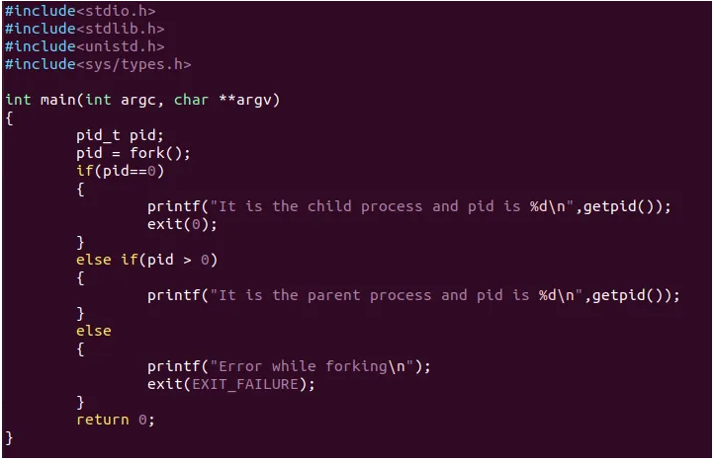
System Calls fork()
SRM Institute of Science and Technology, Ramapuram

Slide 138

System Calls fork()
SRM Institute of Science and Technology, Ramapuram

Slide 139
System Calls wait()
As in the case of a fork, child processes are created and get executed but the parent process is suspended until the child process executes.
In this case, a wait() system call is activated automatically due to the suspension of the parent process.
After the child process ends the execution, the parent process gains control again.
SRM Institute of Science and Technology, Ramapuram

Slide 140
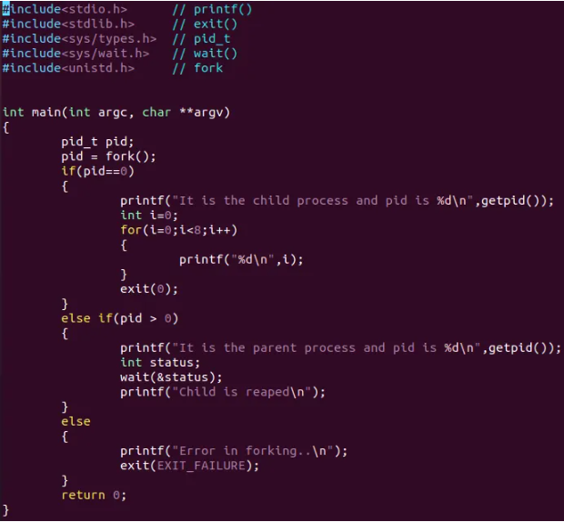
System Calls wait()
SRM Institute of Science and Technology, Ramapuram

Slide 141
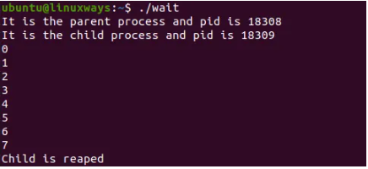
System Calls wait()
SRM Institute of Science and Technology, Ramapuram

Slide 142
System Calls exit()
The exit() is such a function or one of the system calls that is used to terminate the process.
This system call defines that the thread execution is completed especially in the case of a multi-threaded environment.
For future reference, the status of the process is captured.
After the use of exit() system call, all the resources used in the process are retrieved by the operating system and then terminate the process.
The system call Exit() is equivalent to exit().
SRM Institute of Science and Technology, Ramapuram

Slide 143
System Calls exit()
The exit() is such a function or one of the system calls that is used to terminate the process.
This system call defines that the thread execution is completed especially in the case of a multi-threaded environment.
For future reference, the status of the process is captured.
After the use of exit() system call, all the resources used in the process are retrieved by the operating system and then terminate the process.
The system call Exit() is equivalent to exit().
SRM Institute of Science and Technology, Ramapuram

Slide 144
Interprocess Communication
Processes executing concurrently in the operating system may be either
  Independent processes or
  Cooperating processes.
Independent process cannot affect or be affected by the execution of another process.
Cooperating process can affect or be affected by the execution of another process.
SRM Institute of Science and Technology, Ramapuram

Slide 145
Interprocess Communication
Advantages of process cooperation
  Information sharing: Since several users may be interested in the same piece of information, we must provide an environment to allow concurrent access to these types of resources.
  Computation speedup: If we want a particular task to run faster, we must break it into subtasks, each of which will be executing in parallel with the others. Such a speedup can be achieved only if the computer has multiple processing elements.
  Modularity: We may want to construct the system in a modular fashion, dividing the system functions into separate processes or threads.
  Convenience: Even an individual user may have many tasks on which to work at one time. For instance, a user may be editing, printing, and compiling in parallel.
SRM Institute of Science and Technology, Ramapuram

Slide 146
Interprocess Communication
Cooperating processes require an interprocess communication (IPC) mechanism that will allow them to exchange data and information.
There are two fundamental models of interprocess communication:
  shared memory and
  message passing.
In the shared-memory model, a region of memory that is shared by cooperating processes is established. Processes can then exchange information by reading and writing data to the shared region.
In the message-passing model, communication takes place by means of messages exchanged between the cooperating processes.
SRM Institute of Science and Technology, Ramapuram

Slide 147
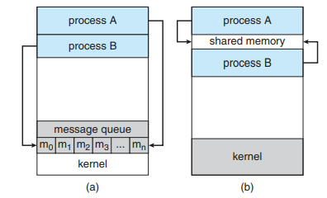
Interprocess Communication
Communications models. (a) Message passing. (b) Shared memory
SRM Institute of Science and Technology, Ramapuram

Slide 148
Shared Memory
Shared-Memory
An area of memory shared among the processes that wish to communicate
The communication is under the control of the users processes not the operating system.
Major issues is to provide mechanism that will allow the user processes to synchronize their actions when they access shared memory.
SRM Institute of Science and Technology, Ramapuram

Slide 149
Shared Memory
Producer-Consumer Problem:
Paradigm for cooperating processes, producer process produces information that is consumed by a consumer process.
For example, a print program produces characters that are consumed by the printer driver. A compiler may produce assembly code, which is consumed by an assembler. The assembler, in turn, may produce object modules, which are consumed by the loader.
  unbounded-buffer places no practical limit on the size of the buffer.
  bounded-buffer assumes that there is a fixed buffer size.
SRM Institute of Science and Technology, Ramapuram

Slide 150
Shared Memory
Bounded-Buffer – Shared-Memory Solution:
Shared data
#define BUFFER_SIZE 10
Typedef struct {
. . .
} item;
item buffer[BUFFER_SIZE];
int in = 0;
int out = 0;
Solution is correct, but can only use BUFFER_SIZE-1 elements
SRM Institute of Science and Technology, Ramapuram

Slide 151
Shared Memory
Bounded-Buffer – Producer Process:
item nextProduced;
while (1) {
while (((in + 1) % BUFFER_SIZE) == out)
; /* do nothing */
buffer[in] = nextProduced;
in = (in + 1) % BUFFER_SIZE;
}
SRM Institute of Science and Technology, Ramapuram

Slide 152
Shared Memory
Bounded-Buffer – Consumer Process:
item nextConsumed;
while (1) {
while (in == out)
; /* do nothing */
nextConsumed = buffer[out];
out = (out + 1) % BUFFER_SIZE;/852
}
SRM Institute of Science and Technology, Ramapuram

Slide 153
Message Passing
Mechanism for processes to communicate and to synchronize their actions.
Message system – processes communicate with each other without resorting to shared variables.
IPC facility provides two operations:
  send(message) – message size fixed or variable
  receive(message)
If P and Q wish to communicate, they need to:
  establish a communication link between them
  exchange messages via send/receive
Implementation of communication link
  physical (e.g., shared memory, hardware bus)
  logical (e.g., logical properties)
SRM Institute of Science and Technology, Ramapuram

Slide 154
Message Passing
Here are several methods for logically implementing a link and the send/receive operations:
  Direct or indirect communication
  Symmetric or asymmetric communication
  Automatic or explicit buffering
  Send by copy or send by reference
  Fixed-sized or variable-sized messages
SRM Institute of Science and Technology, Ramapuram

Slide 155
Message Passing
Implementation Questions:
How are links established?
Can a link be associated with more than two processes?
How many links can there be between every pair of communicating processes?
What is the capacity of a link?
Is the size of a message that the link can accommodate fixed or variable?
Is a link unidirectional or bi-directional?
SRM Institute of Science and Technology, Ramapuram

Slide 156
Message Passing
Naming:
Processes that want to communicate must have a way to refer to each other. They can use either direct or indirect communication.
Direct Communication:
Processes must name each other explicitly:
  send (P, message) – send a message to process P
  receive(Q, message) – receive a message from process Q
Properties of communication link
  Links are established automatically.
  A link is associated with exactly one pair of communicating processes.
  Between each pair there exists exactly one link.
  The link may be unidirectional, but is usually bi-directional.
SRM Institute of Science and Technology, Ramapuram

Slide 157
Message Passing
Indirect Communication:
Messages are directed and received from mailboxes (also referred to as ports).
  Each mailbox has a unique id.
  Processes can communicate only if they share a mailbox.
Properties of communication link
  Link established only if processes share a common mailbox
  A link may be associated with many processes.
  Each pair of processes may share several communication links.
  Link may be unidirectional or bi-directional.
SRM Institute of Science and Technology, Ramapuram

Slide 158
Message Passing
Operations
  create a new mailbox
  send and receive messages through mailbox
  destroy a mailbox
Primitives are defined as:
send(A, message) – send a message to mailbox A
receive(A, message) – receive a message from mailbox A
Mailbox sharing
  P₁, P₂, and P₃ share mailbox A.
  P₁, sends; P₂ and P₃ receive.
  Who gets the message?
Solutions
  Allow a link to be associated with at most two processes.
  Allow only one process at a time to execute a receive operation.
  Allow the system to select arbitrarily the receiver. Sender is notified who the receiver was.
SRM Institute of Science and Technology, Ramapuram

Slide 159
Message Passing
Synchronization:
Message passing may be either blocking or non-blocking.
Blocking is considered synchronous
Non-blocking is considered asynchronous
send and receive primitives may be either blocking or non-blocking.
Buffering:
Queue of messages attached to the link; implemented in one of three ways.
  Zero capacity – 0 messages
    Sender must wait for receiver (rendezvous).
  Bounded capacity – finite length of n messages
    Sender must wait if link full.
  Unbounded capacity – infinite length
    Sender never waits.
SRM Institute of Science and Technology, Ramapuram

Slide 160
Pipe()
pipe() is a system call that facilitates inter-process communication.
It opens a pipe, which is an area of main memory that is treated as a "virtual file". The pipe can be used by the creating process, as well as all its child processes, for reading and writing.
One process can write to this "virtual file" or pipe and another related process can read from it.
If a process tries to read before something is written to the pipe, the process is suspended until something is written.
The pipe system call finds the first two available positions in the process's open file table and allocates them for the read and write ends of the pipe. Recall that the open system call allocates only one position in the open file table.
SRM Institute of Science and Technology, Ramapuram

Slide 161
Pipe()
Syntax in a C/C++ program:
    #include <unistd.h>
    int pip[2];
    (void) pipe(pip);
With error checking:
    #include <unistd.h>
    int pip[2];
    int result;
    result = pipe(pip);
    if (result == -1)
    {
    perror("pipe");
    exit(1);
    }
SRM Institute of Science and Technology, Ramapuram

Slide 162
Process Synchronization
Processes can execute concurrently
  May be interrupted at any time, partially completing execution
Concurrent access to shared data may result in data inconsistency.
Maintaining data consistency requires mechanisms to ensure the orderly execution of cooperating processes.
Shared-memory solution to bounded-butter problem allows at most n – 1 items in buffer at the same time. A solution, where all N buffers are used is not simple.
Illustration of the problem:
  Suppose that we wanted to provide a solution to the consumer-producer problem that fills all the buffers. We can do so by having an integer counter that keeps track of the number of full buffers. Initially, counter is set to 0. It is incremented by the producer after it produces a new buffer and is decremented by the consumer after it consumes a buffer.
SRM Institute of Science and Technology, Ramapuram

Slide 163
Process Synchronization
The code for the producer process can be modified as follows:
while (true)
{
/* produce an item in next produced */
while (counter == BUFFER SIZE)
; /* do nothing */
buffer[in] = next produced;
in = (in + 1) % BUFFER SIZE;
counter++;
}
SRM Institute of Science and Technology, Ramapuram

Slide 164
Process Synchronization
The code for the consumer process can be modified as follows:
while (true)
{
while (counter == 0)
; /* do nothing */
next consumed = buffer[out];
out = (out + 1) % BUFFER SIZE;
counter--;
/* consume the item in next consumed */
}
SRM Institute of Science and Technology, Ramapuram

Slide 165
Process Synchronization
Although the producer and consumer routines shown above are correct separately, they may not function correctly when executed concurrently
As an illustration, suppose that the value of the variable counter is currently 5 and that the producer and consumer processes concurrently execute the statements “counter++” and “counter--”.
Following the execution of these two statements, the value of the variable counter may be 4, 5, or 6! The only correct result, though, is counter == 5, which is generated correctly if the producer and consumer execute separately.
We can show that the value of counter may be incorrect as follows. Note that the statement “counter++” may be implemented in machine language as follows:
register1 = counter
register1 = register1 + 1
counter = register1
where register1 is one of the local CPU registers.
SRM Institute of Science and Technology, Ramapuram

Slide 166
Process Synchronization
Similarly, the statement “counter--” is implemented as follows:
register2 = counter
register2 = register2 − 1
counter = register2
where again register2 is one of the local CPU registers.
Even though register1 and register2 may be the same physical register remember that the contents of this register will be saved and restored by the interrupt handler.
The concurrent execution of “counter++” and “counter--” is equivalent to a sequential execution in which the lower-level statements presented previously are interleaved in some arbitrary order.
One such interleaving is the following:
T0: producer execute register1 = counter {register1 = 5}
T1: producer execute register1 = register1 + 1 {register1 = 6}
T2: consumer execute register2 = counter {register2 = 5}
T3: consumer execute register2 = register2 − 1 {register2 = 4}
T4: producer execute counter = register1 {counter = 6}
T5: consumer execute counter = register2 {counter = 4}
SRM Institute of Science and Technology, Ramapuram

Slide 167
Process Synchronization
Notice that we have arrived at the incorrect state “counter == 4”, indicating that four buffers are full, when, in fact, five buffers are full. If we reversed the order of the statements at T4 and T5, we would arrive at the incorrect state “counter == 6”.
Race Condition
The situation where several processes access – and manipulate shared data concurrently. The final value of the shared data depends upon which process finishes last.
To prevent race conditions, concurrent processes must be synchronized.
SRM Institute of Science and Technology, Ramapuram

Slide 168
Critical Section Problem
Consider system of n processes {p₀, p₁, … p_{n-1}}
Each process has critical section segment of code
  Process may be changing common variables, updating table, writing file, etc
  When one process in critical section, no other may be in its critical section
Critical section problem is to design protocol to solve this
Each process must ask permission to enter critical section in entry section, may follow critical section with exit section, then remainder section.
SRM Institute of Science and Technology, Ramapuram

Slide 169
Critical Section Problem
Solution to Critical-Section Problem
Mutual Exclusion. If process P_{i} is executing in its critical section, then no other processes can be executing in their critical sections.
Progress. If no process is executing in its critical section and there exist some processes that wish to enter their critical section, then the selection of the processes that will enter the critical section next cannot be postponed indefinitely.
Bounded Waiting. A bound must exist on the number of times that other processes are allowed to enter their critical sections after a process has made a request to enter its critical section and before that request is granted.
  Assume that each process executes at a nonzero speed
  No assumption concerning relative speed of the n processes.
SRM Institute of Science and Technology, Ramapuram

Slide 170

Critical Section Problem
Two-Process Solutions
Consider an algorithm that is applicable to only two processes at a time with the following notation.
Initial notation
Only 2 processes, P0 and P1
When usually just presenting process Pi, always denotes other process Pj (i != j).
General structure of process P_{i}(other process P_{j})
General structure of process P_{i}
SRM Institute of Science and Technology, Ramapuram

Slide 171
Critical Section Problem
Algorithm 1
Shared variables:
  int turn;
  initially turn = 0
  turn - i⇒P_{i} can enter its critical section
Process P_{i}
do {
while (turn != i) ;
critical section
turn = j;
reminder section
} while (1);
Satisfies mutual exclusion, but not progress
SRM Institute of Science and Technology, Ramapuram

Slide 172
Critical Section Problem
Drawback
processes must strictly alternate
  Pace of execution of one process is determined by pace of execution of other processes
if one processes fails other process is permanently blocked
Problem
Does not retain information about the state of each progress, it remembers only which process is allowed to enter its critical section.
SRM Institute of Science and Technology, Ramapuram

Slide 173
Critical Section Problem
Algorithm 2
Shared variables
  boolean flag[2];
  initially flag [0] = flag [1] = false.
  flag [i] = true⇒P_{i} ready to enter its critical section
Process P_{i}
do {
flag[i] := true;
while (flag[j]) ;
critical section
flag [i] = false;
remainder section
} while (1);
Satisfies mutual exclusion, but not progress requirement.
This approach may lead to dead lock.
SRM Institute of Science and Technology, Ramapuram

Slide 174
Critical Section Problem
Algorithm 3
Combined shared variables of algorithms 1 and 2.
Process P_{i}
do {
flag [i]:= true;
turn = j;
while (flag [j] and turn = j) ;
critical section
flag [i] = false;
remainder section
} while (1);
Meets all three requirements; solves the critical-section problem for two processes.
SRM Institute of Science and Technology, Ramapuram

Slide 175
Process Synchronization
Processes can execute concurrently
  May be interrupted at any time, partially completing execution
Concurrent access to shared data may result in data inconsistency.
Maintaining data consistency requires mechanisms to ensure the orderly execution of cooperating processes.
Shared-memory solution to bounded-butter problem allows at most n – 1 items in buffer at the same time. A solution, where all N buffers are used is not simple.
Illustration of the problem:
  Suppose that we wanted to provide a solution to the consumer-producer problem that fills all the buffers. We can do so by having an integer counter that keeps track of the number of full buffers. Initially, counter is set to 0. It is incremented by the producer after it produces a new buffer and is decremented by the consumer after it consumes a buffer.
SRM Institute of Science and Technology, Ramapuram

Slide 176
Process Synchronization
The code for the producer process can be modified as follows:
while (true)
{
/* produce an item in next produced */
while (counter == BUFFER SIZE)
; /* do nothing */
buffer[in] = next produced;
in = (in + 1) % BUFFER SIZE;
counter++;
}
SRM Institute of Science and Technology, Ramapuram

Slide 177
Process Synchronization
The code for the consumer process can be modified as follows:
while (true)
{
while (counter == 0)
; /* do nothing */
next consumed = buffer[out];
out = (out + 1) % BUFFER SIZE;
counter--;
/* consume the item in next consumed */
}
SRM Institute of Science and Technology, Ramapuram

Slide 178
Process Synchronization
Although the producer and consumer routines shown above are correct separately, they may not function correctly when executed concurrently
As an illustration, suppose that the value of the variable counter is currently 5 and that the producer and consumer processes concurrently execute the statements “counter++” and “counter--”.
Following the execution of these two statements, the value of the variable counter may be 4, 5, or 6! The only correct result, though, is counter == 5, which is generated correctly if the producer and consumer execute separately.
We can show that the value of counter may be incorrect as follows. Note that the statement “counter++” may be implemented in machine language as follows:
register1 = counter
register1 = register1 + 1
counter = register1
where register1 is one of the local CPU registers.
SRM Institute of Science and Technology, Ramapuram

Slide 179
Process Synchronization
Similarly, the statement “counter--” is implemented as follows:
register2 = counter
register2 = register2 − 1
counter = register2
where again register2 is one of the local CPU registers.
Even though register1 and register2 may be the same physical register remember that the contents of this register will be saved and restored by the interrupt handler.
The concurrent execution of “counter++” and “counter--” is equivalent to a sequential execution in which the lower-level statements presented previously are interleaved in some arbitrary order.
One such interleaving is the following:
T0: producer execute register1 = counter {register1 = 5}
T1: producer execute register1 = register1 + 1 {register1 = 6}
T2: consumer execute register2 = counter {register2 = 5}
T3: consumer execute register2 = register2 − 1 {register2 = 4}
T4: producer execute counter = register1 {counter = 6}
T5: consumer execute counter = register2 {counter = 4}
SRM Institute of Science and Technology, Ramapuram

Slide 180
Process Synchronization
Notice that we have arrived at the incorrect state “counter == 4”, indicating that four buffers are full, when, in fact, five buffers are full. If we reversed the order of the statements at T4 and T5, we would arrive at the incorrect state “counter == 6”.
Race Condition
The situation where several processes access – and manipulate shared data concurrently. The final value of the shared data depends upon which process finishes last.
To prevent race conditions, concurrent processes must be synchronized.
SRM Institute of Science and Technology, Ramapuram

